Slide 1

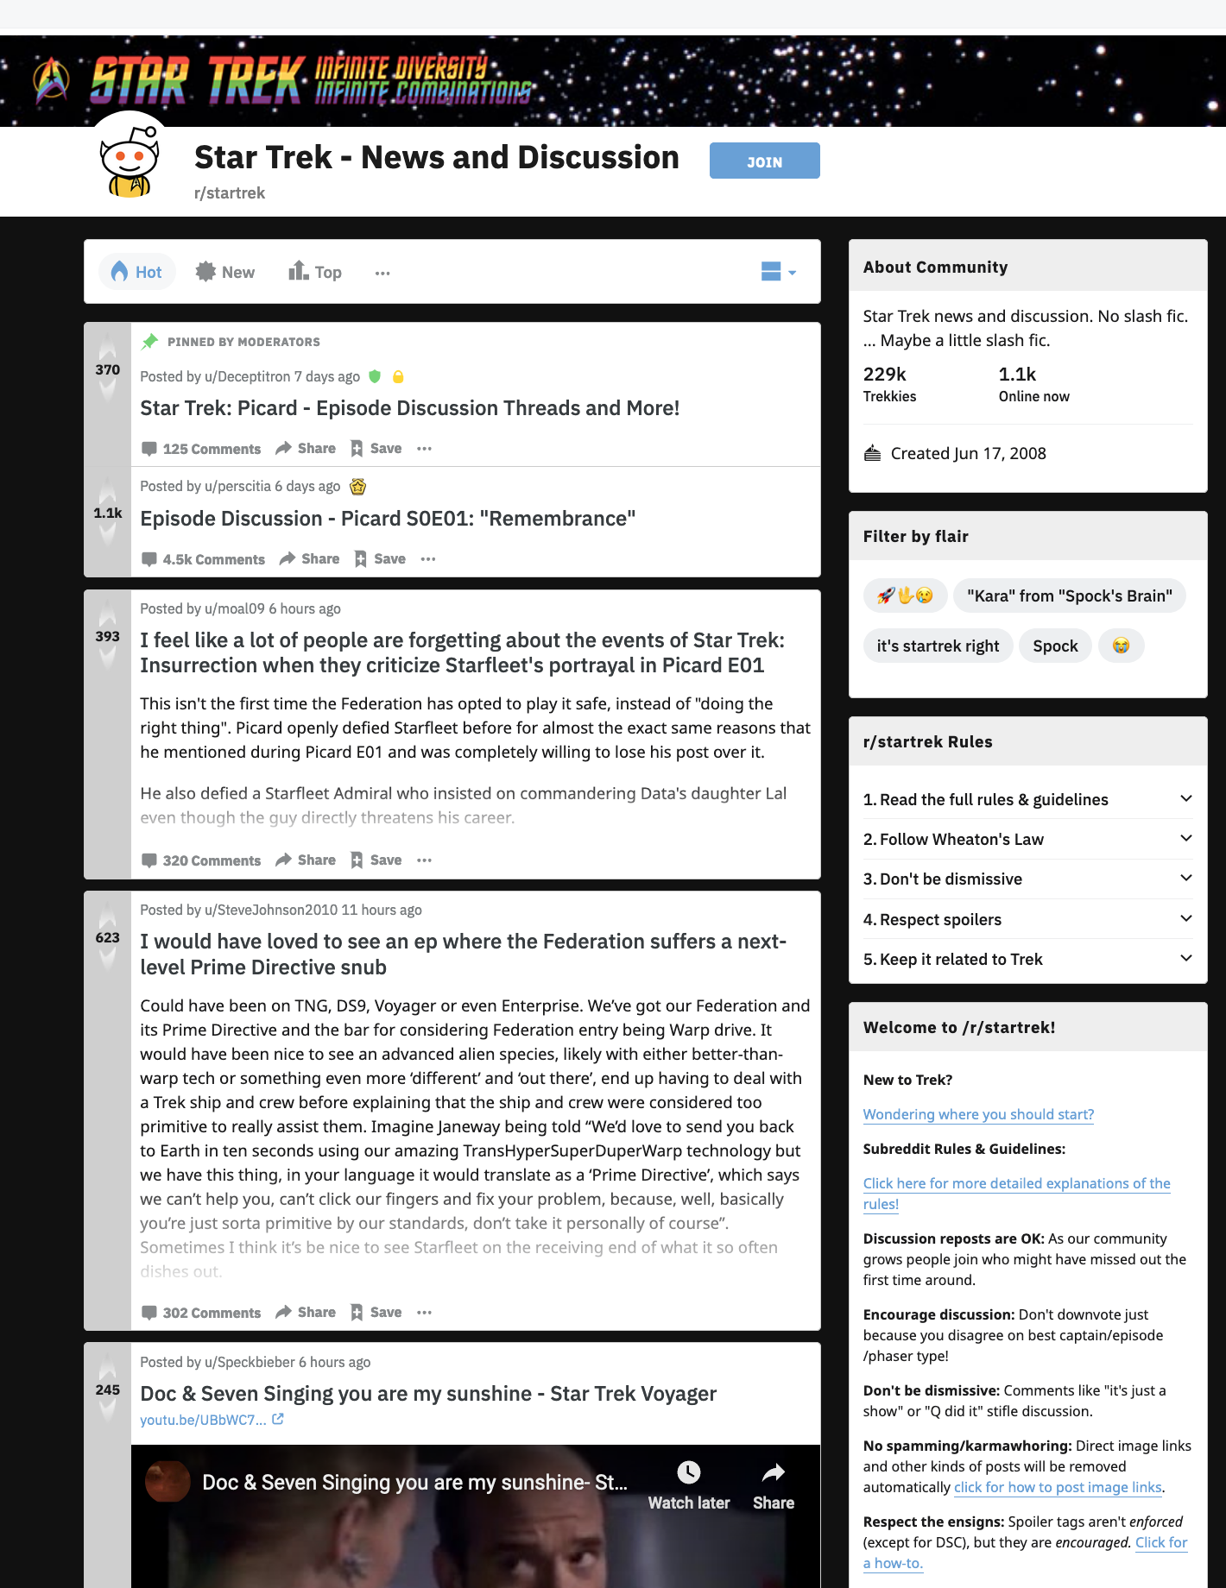


vs.
r/
r/
Using classification models
to predict which subreddit a post belongs to

Slide 2



Problem Statement: r/scifi_universes needs a bot to suggest what other subreddits a post should be cross-posted to.
r/scifi_universes

Slide 3
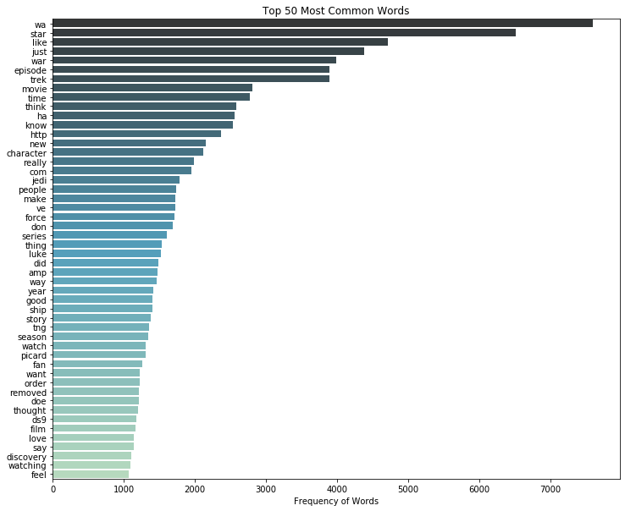
Pre-processing: Custom Stop Words
Process to determine custom stop words:
Top 50 most common words in the dataset:
Two types:
Words that are common in both subreddits, such as: like, just, know, new etc.
Words that are particular to only one of the subreddits. e.g. jedi, picard etc.
The first type will be appended to the default Stop Words and removed; the second type will stay.
Additionally, “giveaways” words such as “starwars”, “war”, “startrek”, “trek” will be appended to the default Stop Words and removed.

Slide 4
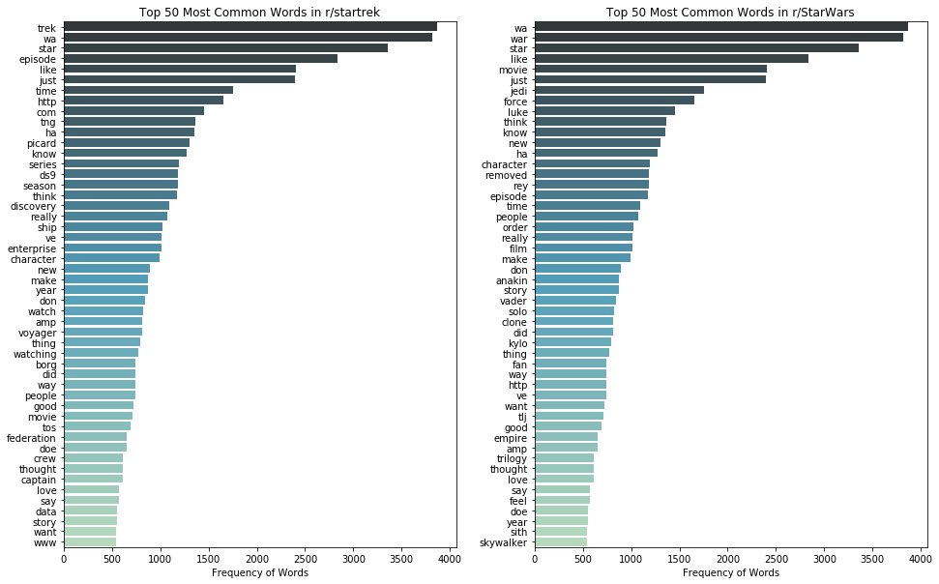


Pre-processing: Custom Stop Words

Slide 5
Model Selection
Model Name | Multinomial Naive Bayes | Gaussian Naive Bayes | Logistic Regression 1 | Logistic Regression 2 | KNN | SVM
Transformer | CountVectorizer | TfidfVectorizer, Customized Transformer | CountVectorizer | TfidfVectorizer | CountVectorizer | CountVectorizer
Estimator | MultinomialNB | GaussianNB | Logistic Regression | Logistic Regression | Kneighbors Classifier | SVC
AUC ROC (on Test Data) | 0.98327 | 0.95384 | 0.98121 | 0.98119 | 0.89864 | 0.97668
Run Time (seconds) | 22.85 | 26.29 | 51.25 | 47.16 | 64.28 | 416.88
* Baseline Model: AUC ROC = 0.5

Slide 6
Model Selection
Model Name | Multinomial Naive Bayes | Gaussian Naive Bayes | Logistic Regression 1 | Logistic Regression 2 | KNN | SVM
Transformer | CountVectorizer | TfidfVectorizer, Customized Transformer | CountVectorizer | TfidfVectorizer | CountVectorizer | CountVectorizer
Estimator | MultinomialNB | GaussianNB | Logistic Regression | Logistic Regression | Kneighbors Classifier | SVC
AUC ROC (on Test Data) | 0.98327 | 0.95384 | 0.98121 | 0.98119 | 0.89864 | 0.97668
Run Time (seconds) | 22.85 | 26.29 | 51.25 | 47.16 | 64.28 | 416.88
Best Prediction Model
Best Interpretation Model
* Baseline Model: AUC ROC = 0.5

Slide 7
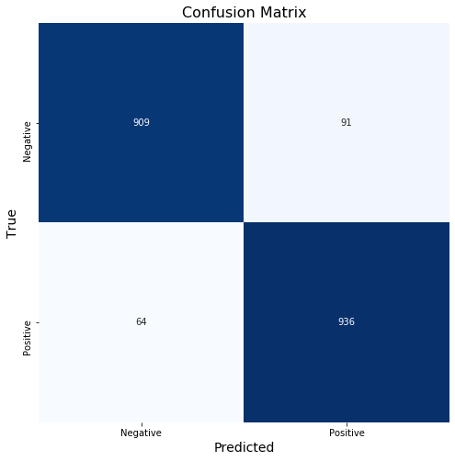
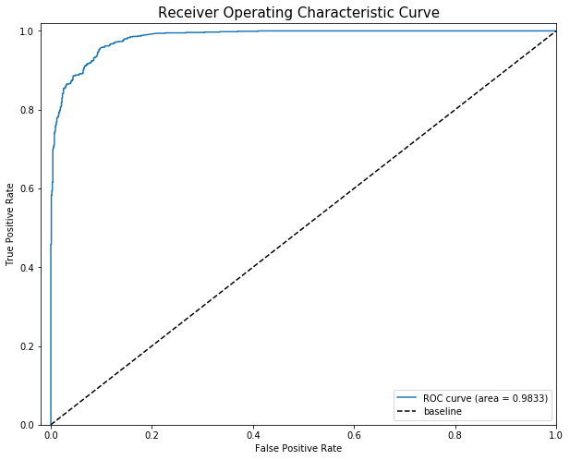
Model Evaluation Part I Prediction Model: Multinomial Naive Bayes

Slide 8
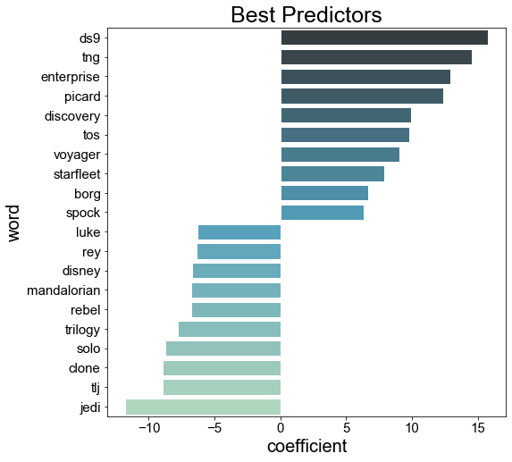

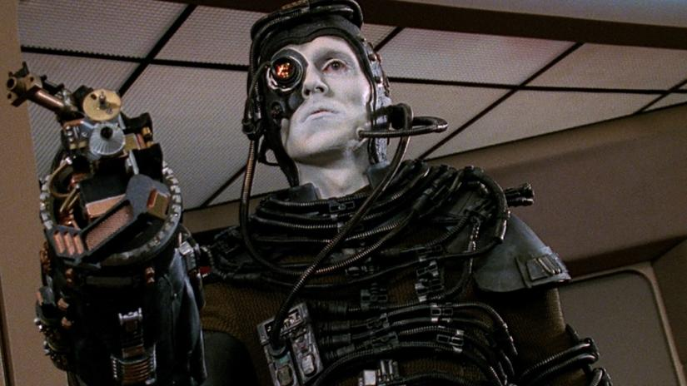

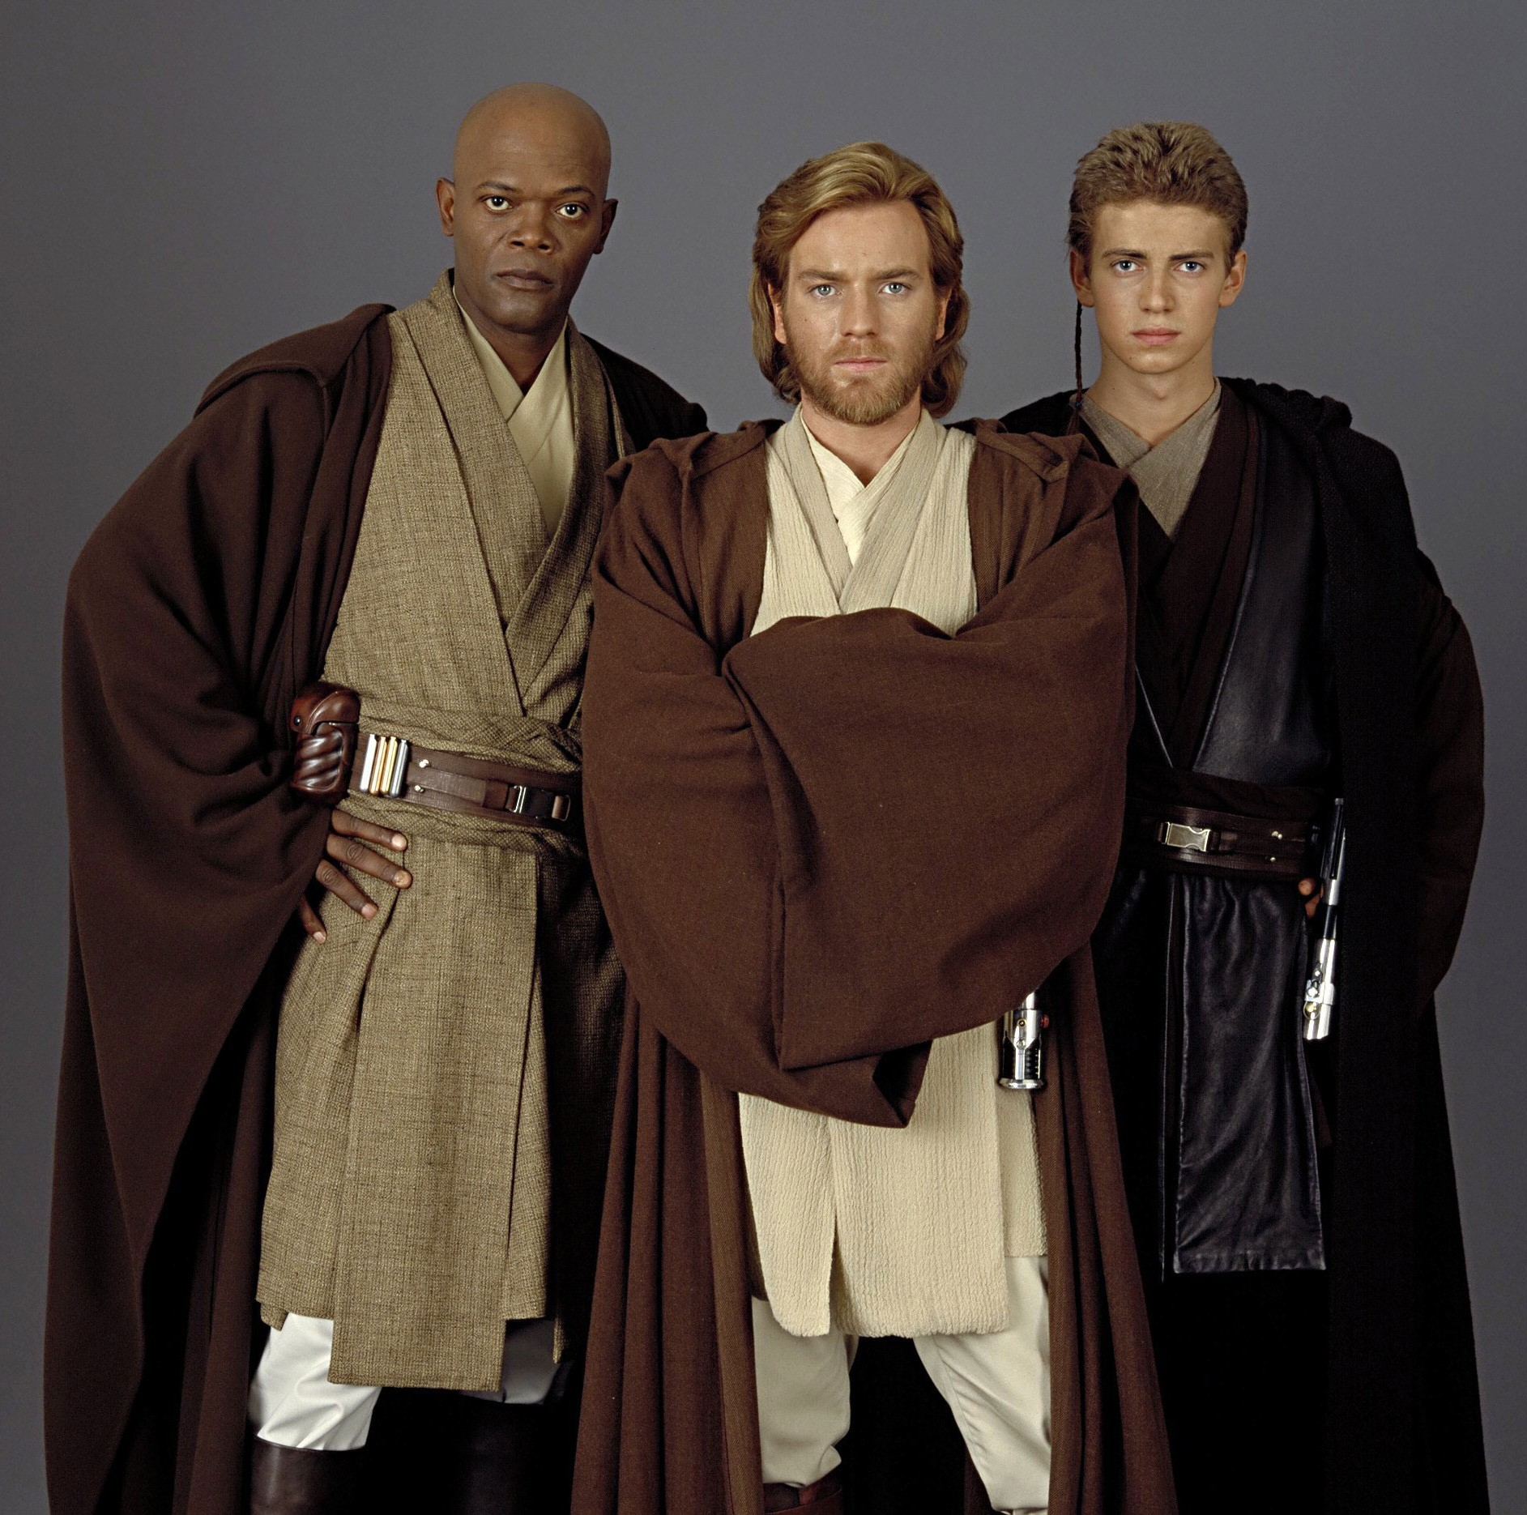
Model Evaluation Part II Interpretation Model: Logistic Regression + CountVectorizer
“picard”
“borg”
“mandalorian”
“jedi”

Slide 9

Conclusion and Future Steps
Multinomial Naive Bayes is a good model to predict which subreddit posts on r/scifi_universes should crosspost to, i.e. r/startrek or r/StarWars.
Limitations of our model:
During the data collection process, information such as which subreddit has more ‘is_self’ posts was lost.
We didn’t include comments to train our models.
Future Steps: go beyond binary classes.
e.g. add class r/BSG: Battlestar Galactica

